Slide 1
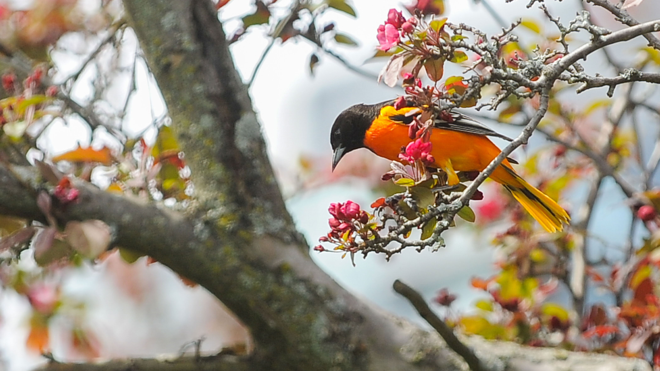
Phenology - the study of periodicity
and timing of biological events and its
relationship to climate and landscape
variation over seasons and years
Phenology and its change has
cascading impacts on communities
via shifted biotic interactions, and ultimately ecosystem services

Slide 2
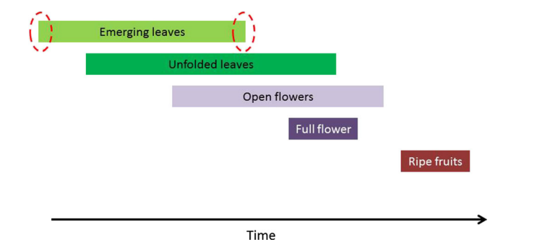
Plant phenology is multifaceted and complex
Describing phenology is surprisingly complicated
You can think about phenology as having phases
or stages, or you can think of “events”
For example, a plant may have unfolding leaves that then later transition to unfolded leaves
A plant can also simultaneously have unfolding and unfolded leaves
A very comprehensive set of phenology definitions was published by Stucky et al. (I am in author) in the Plant Phenology Ontology

Slide 3
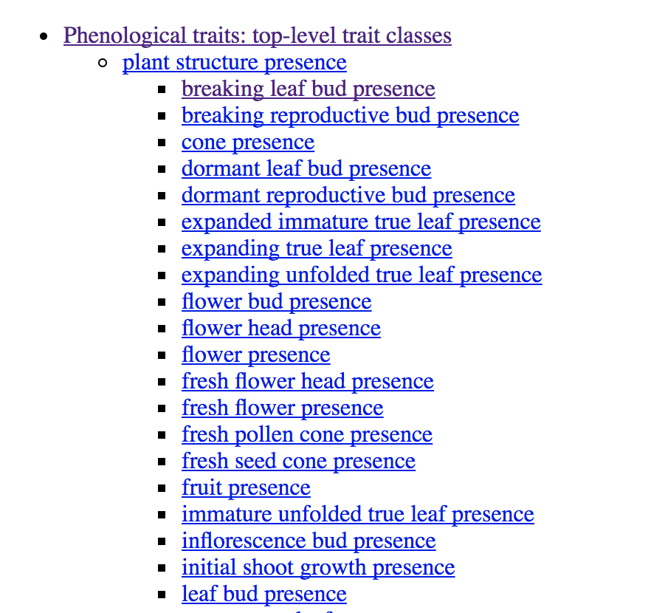
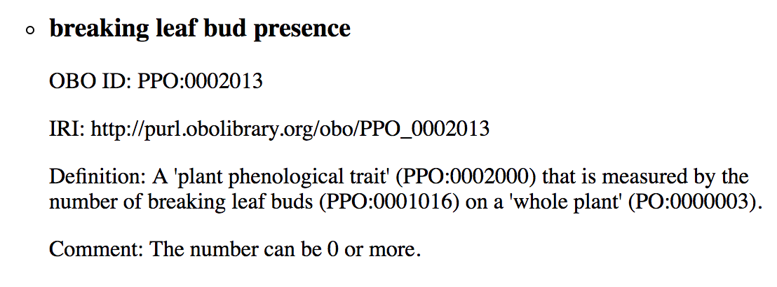
The Plant Phenology Ontology
A set of terms, definitions and logical axioms that can be used to describe phenology traits of plants
Identifiers for terms and meaning all published for others to use

Slide 4
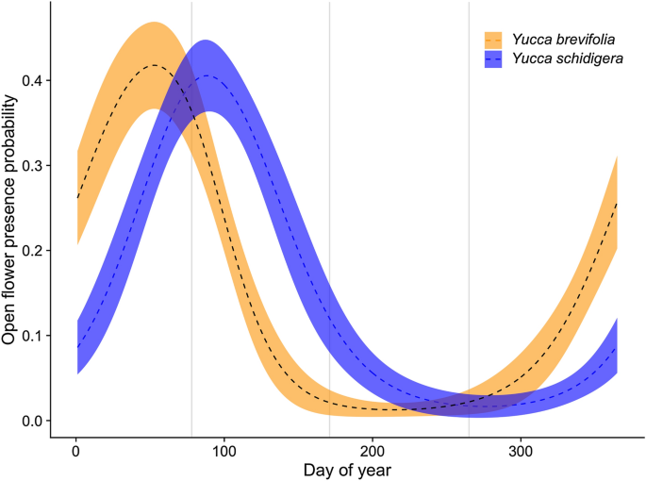
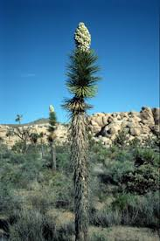
Phenology – how do we measure it?
Here is an actual example from two Yucca
species showing a typical phenological curve
This curve shows the probability of
open flowers
These curves were estimated using data
(more on that later) and illustrate some key
aspects of phenology
Three key things: Often a peak to the curve,
and often distinctive onset and offset
to phenology

Slide 5
Phenometrics
With a curve like this we can measure any arbitrary cumulative probability of flowering
We can define onset as the point where the probability of an event (budburst, flowering) transitions from zero to non-zero
We can also define, for example, a 5% cumulative probability of flowering (5% onset)
Or 10% flowering onset
As well as 90% or 95% (end of curve) offset/termination
Or 50% mean phenology (often near the peak)
Whatever the case, these measures are often referred to as “PHENOMETRICS”
They are almost always measured in DOY (day of year)

Slide 6

Because phenology is often about day of year, it brings home some very unique challenges with date data wrangling
I recently kept not having days add up properly for an analysis
Until I remembered I DIDN’T ACCONT for leap years. Argh
Totally a Pirates of Penzance moment

Slide 7
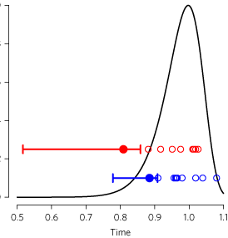
But how do you actually make an estimate?
Phenology estimation is almost its own workshop
I will focus here on presence-only modeling
One class of estimators utilize what is known as the Weibull distribution that has statistical properties that make it good at estimating the onset or end of events
That estimator and others (including quantile estimates) are folded into a package called Phenesse
All you need to make an estimate is a vector of observations containing the day of year of when a presence state was detected (e.g. an open flower)
All of these estimates have uncertainty

Slide 8

Phenology Data Wrangling
What this talk ISN’T about:
Phenology studies I have done
How to design a phenology study
The breadth of approaches to studying phenology or breadth of phenology concepts
Philosophical discussions about phenology or a criticism of different methods for phenology estimation
How to write code
Why phenology is cool (or uncool)

Slide 9
But…
I do want to introduce one concept that might be valuable – Macrophenology:
(from Gallant 2021, AJB): “By comparison, our understanding of regional- and global-scale phenology has been largely limited to remote sensing of green-up without the ability to differentiate among plant species. However, a new generation of analytical tools and data sources—including enhanced remote sensing products, digitized herbarium specimen data, and public participation in science—now permits investigating patterns and drivers of phenology across extensive taxonomic, temporal, and spatial scales, in an emerging field that we call macrophenology”

Slide 10
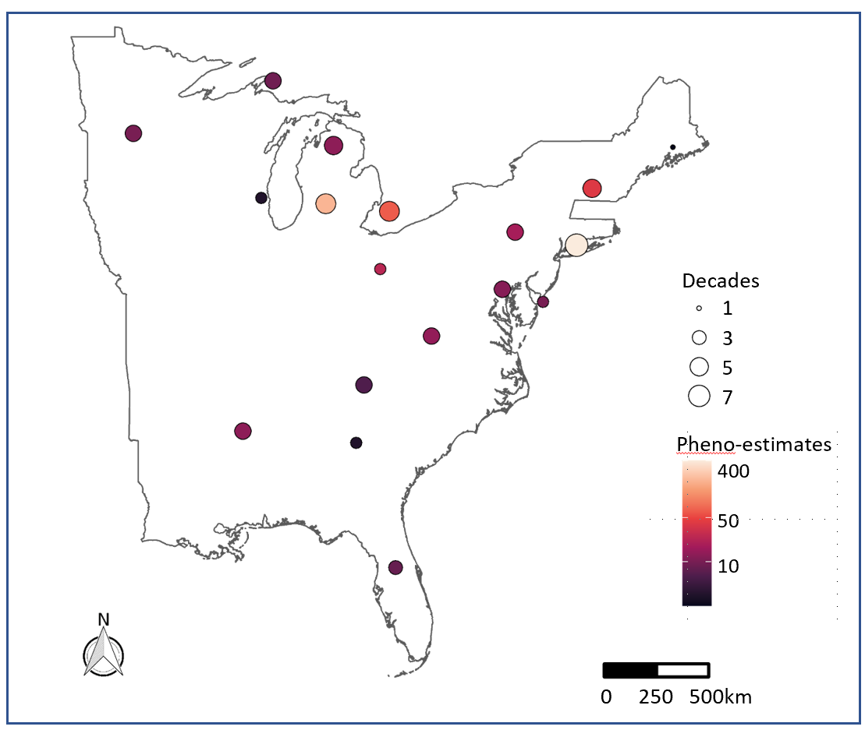
Phenometrics
Macrophenology studies usually are estimating phenology across space and time
Here you can see spatial and temporal pheno-estimate density for insect flight phenology across Eastern USA
These estimates were made at coarse resolution – 250km x 250km grid cells.
Spatial grain is often determined by data availability*

Slide 11
How do we access macrophenology data resources?
I will cover four resources, with a focus on #1:
Herbarium Specimens
Citizen science records
Literature resources
In-situ data from sensors
If anyone is interested, I can discuss remote sensing data briefly as well

Slide 12
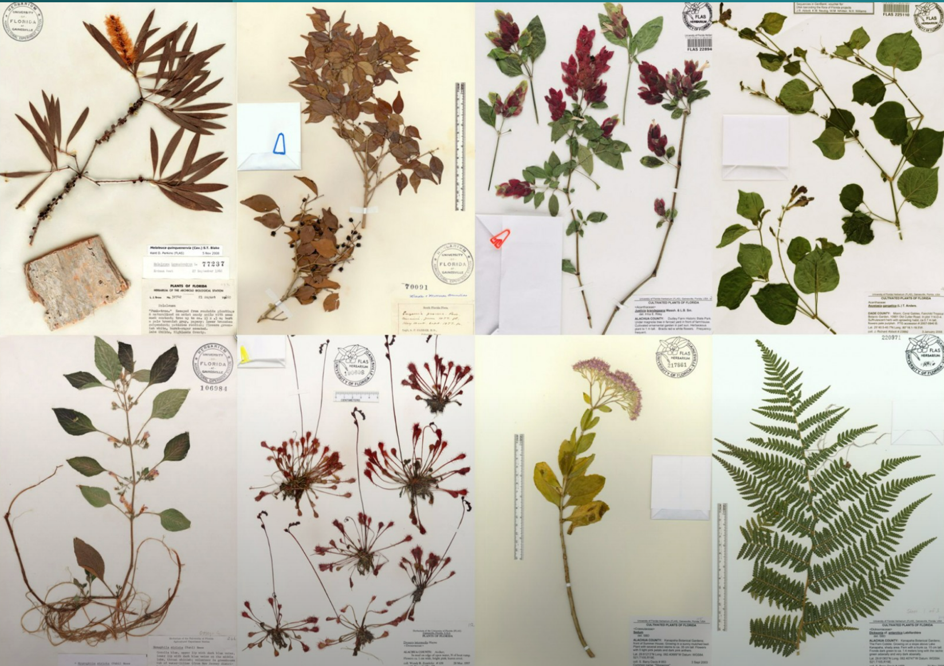
Digitized herbarium specimens are one of our best sources of historical phenology data
but there are a lot of challenges and pitfalls
- Starting with “how to download them”

Slide 13
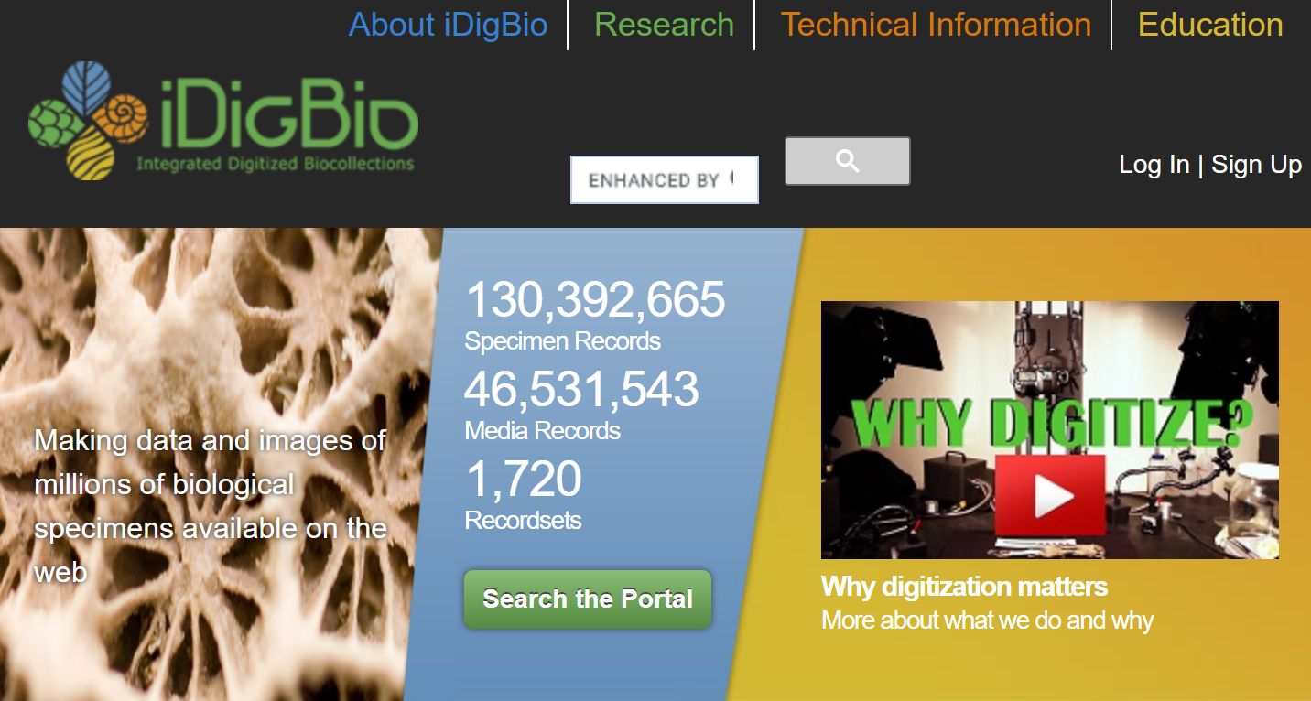
iDigBio is a great source of image data. For maximum coverage, you should download specimens from GBIF and Symbiota as well. You should filter for records with images if you want to score phenology (not always a requirement)

Slide 14
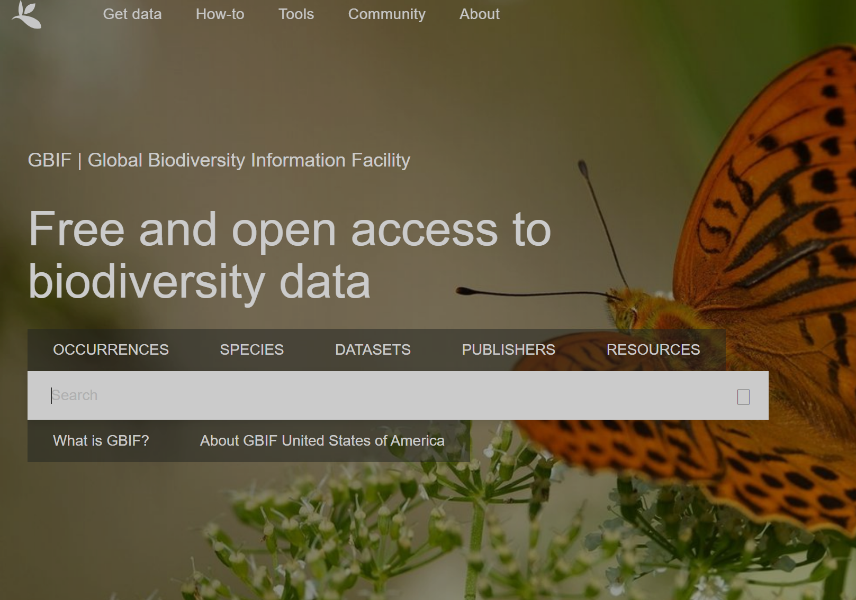
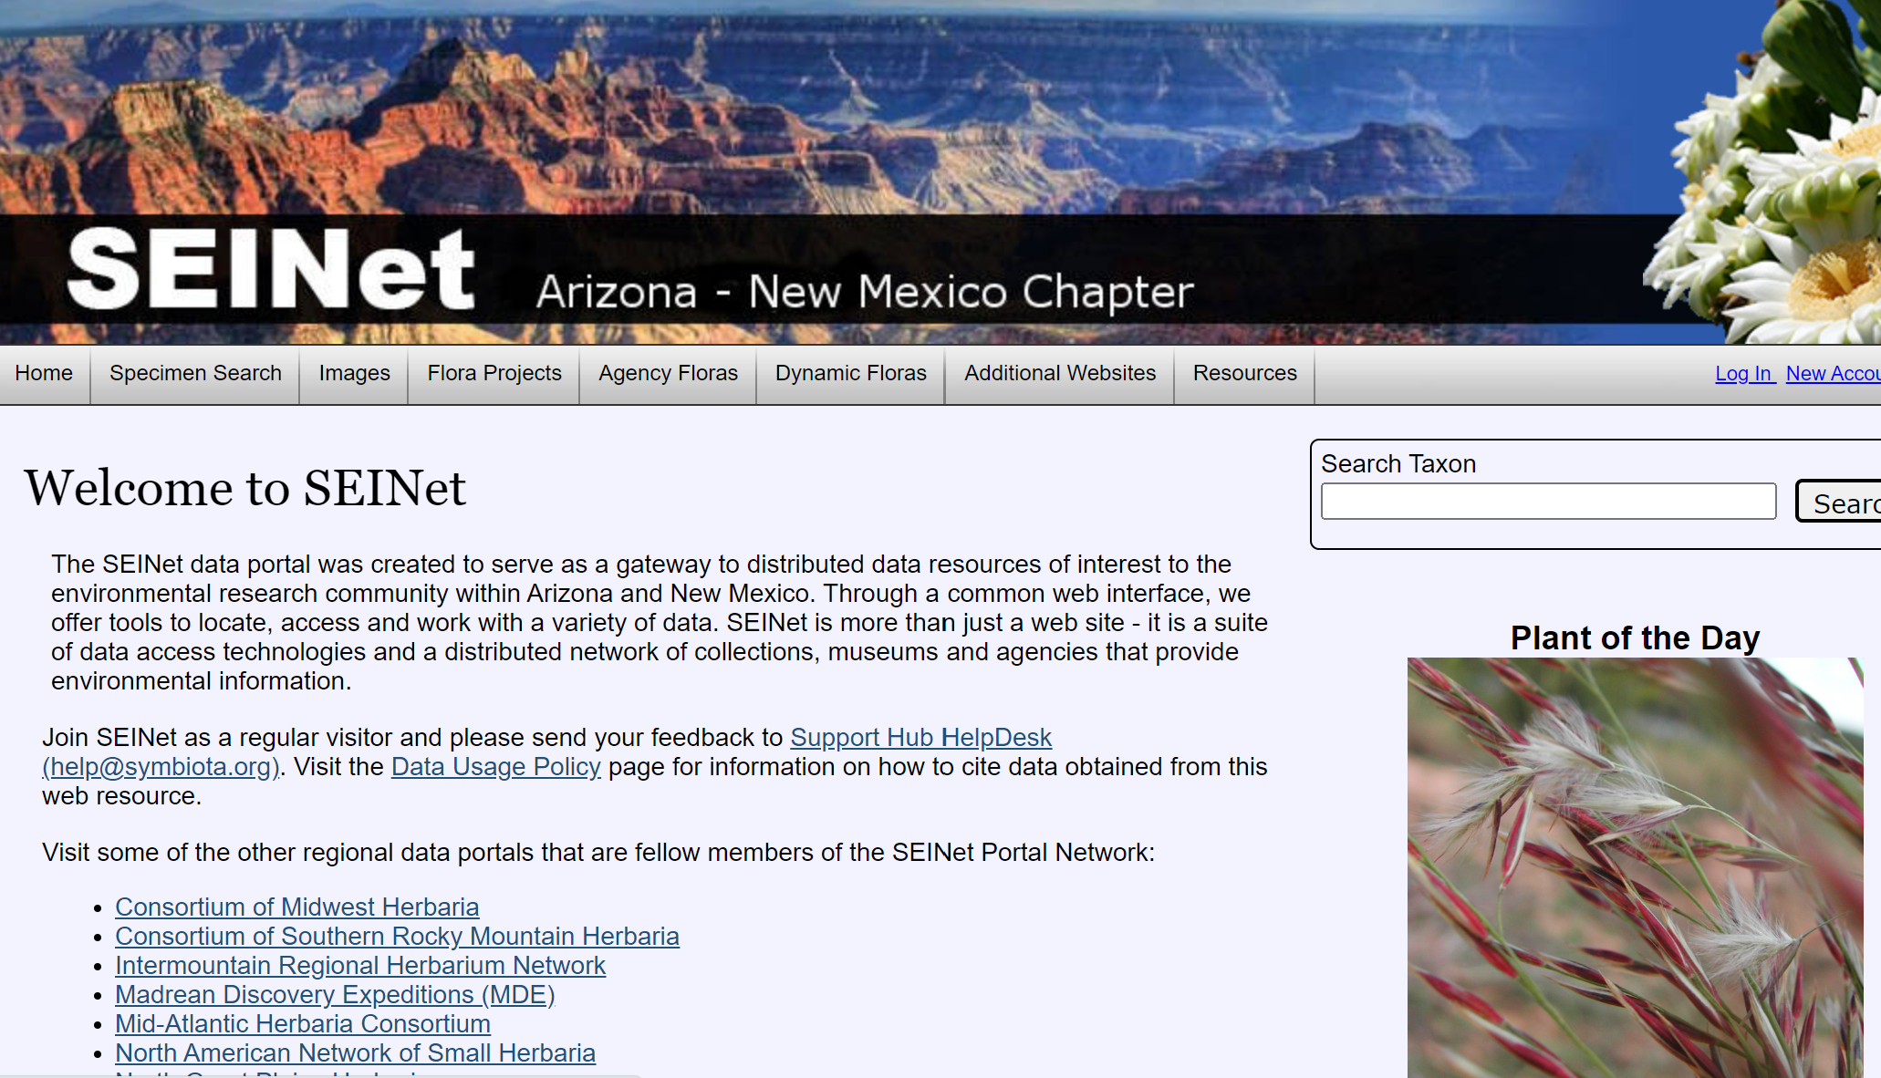
You will want to use R or the web portal itself to search for occurrence datasets for taxa of interest. Combining data across portals is a pain because field names are less consistent that you’d hope for given these are all Darwin Core compliant

Slide 15
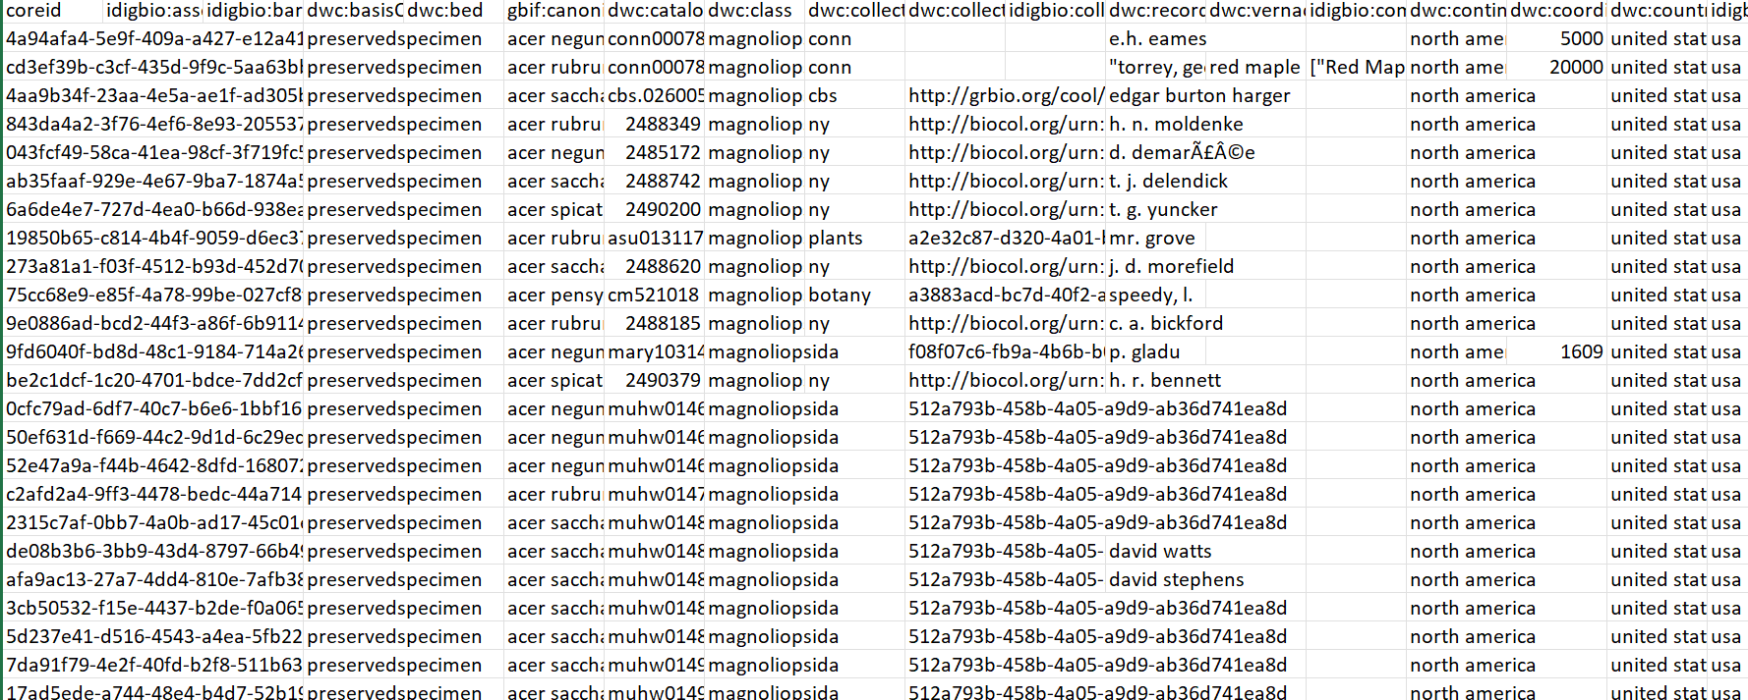
SO YOU GET A GIANT CSV FILE – WHAT NEXT?
How to process this giant download?
Tidyverse is your friend
For example,use dplyr::select to choose a small subset of fields.
For phenology I often just keep: id field (coreid for iDB), recordedBy, country, state, county, eventData, scientificName and mediaRecords
I also love the package “anytime” for helping to manage dates – dates often are a REAL problem along multiple dimension.
A snippet of a data download from iDigBio for Acer specimens.
Full dataset has > 85 COLUMNS (!) and mixes Darwin Core and iDigBio
-specific fields

Slide 16

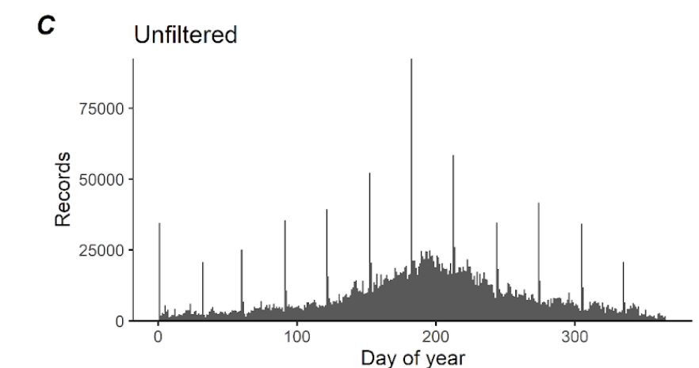
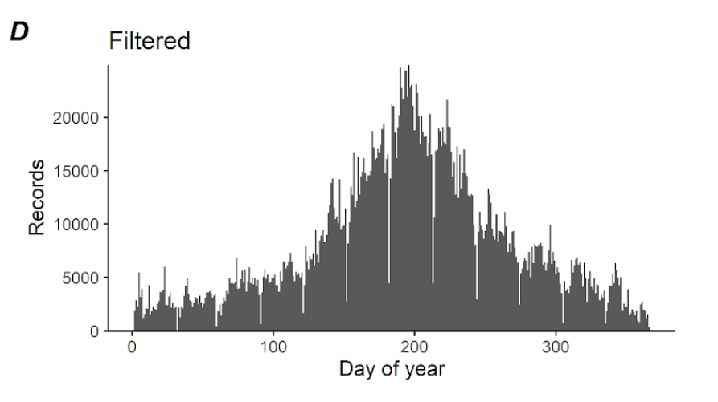
Specimen record and dates – things that make me cry
1. Improbable dates: 7/1/1032 or 12/30/4092
2. Dates that only have month and year but are
listed on the first of the month
3. Dates that are transposed, for example
3/6/1989 as digitized but actual date is
6/3/1989
While #1 is bad, it can be filtered easily. #2 and
#3 are real pains that need careful attention
Filter out 1st of month recs

Slide 17


Let’s Put This into a Recipe, Part 1: Assembling your data across aggregators:
Download occurrence data from aggregators
Reduce your fields to a core set needed
Use anytime and/or lubridate to help assure data formats are ok
Add a field that reminds you which record came from which aggregator (e.g. dplyr::mutate(dsource="iDigBio") )
Concat your dataframes from each aggregator
I use dplyr::distinct to select distinct records date, recordedBy, county, stateProvince

Slide 18
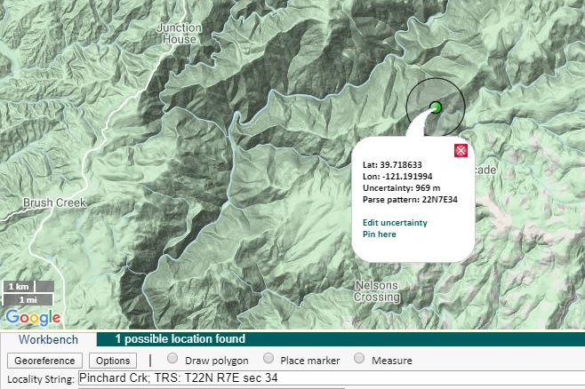
What about georeferences?
This is where herbarium data is particularly tricky!
To get credible estimates of phenology for a species during a year, you typically need ~10 records where the state of interest (e.g. flowers) are present in a region and year of interest.
Georeferences are only available for ~30% of records online, a major data limitation.
I’ve used county centroid as a proxy estimate: >80% of records have a county/state/country.
If you do use a coarse approximation (e.g. county centroid) for georeferences, you need to fit pheno-estimates at even coarser resolution

Slide 19

So we have a cleaned, de-duped, integrated set of specimens occurrences data in a dataframe – what next?
We need to download images using URLs in occurrence dataset
We need to look at the images and annotate phenology presence/absence
We need to join those phenology pres/abs. data back to occ. Dataset
We need to make some analysis choices prior to generating phenoestimates

Slide 20

Downloading images from aggregators
I use R for this; basically the function “download.file” wrapped up in a loop
Which grabs each URL to an image for each record in your dataframe
And saves those images to your hard drive
There are challenges here too: multiple images per record etc.
You can also use this handy tool for iDigBio written in Python by Brian Stucky: https://gitlab.com/stuckyb/herbarium_phenology/-/blob/master/src/download_images.py

Slide 21
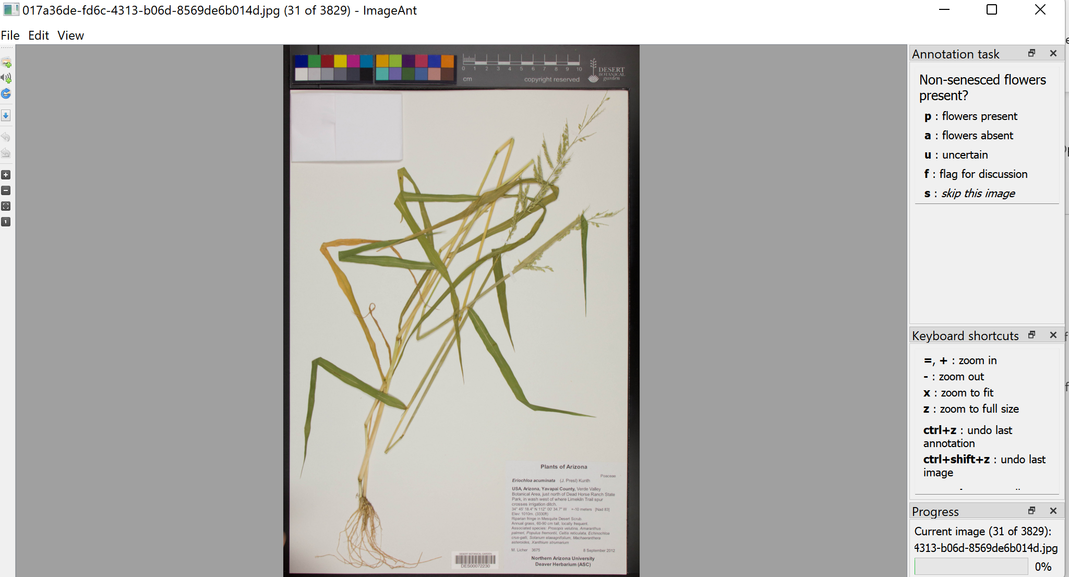
So you downloaded images: What next? You have to score phenology!
We use this great tool called “imageant” also dev’d by B. Stucky
Imageant is a tool for annotating images
You can write your own simple script for keystrokes that capture what you see
It gives you zoom/pam options
It allows you to set up multiple conditionals to simplify scoring
And is highly crash-proof

Slide 22
Recipe 2: Getting your data ready for analyses
Download images by finding the URLs that point to remote images in your specimen records
Use a tool that helps you make annotation fast and easy (imageant is awesome for this)
Join your annotations back to the dataframe that has specimen metadata
Filter out records that don’t have the phenophase of interest present (if you are doing presence-only modeling)

Slide 23
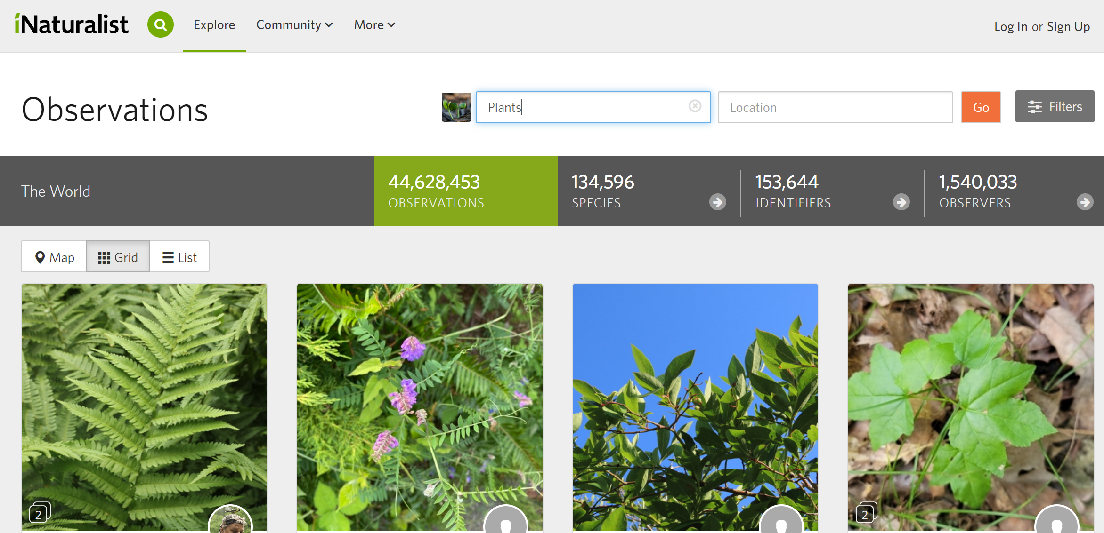
What about other data sources?
iNaturalist is a great resource for phenology
And the approach for gathering phenology data from iNat is the same as for herbarium data
In fact, GBIF already has a lot of the Research Grade specimens in its platform
You still need to annotate phenology

Slide 24

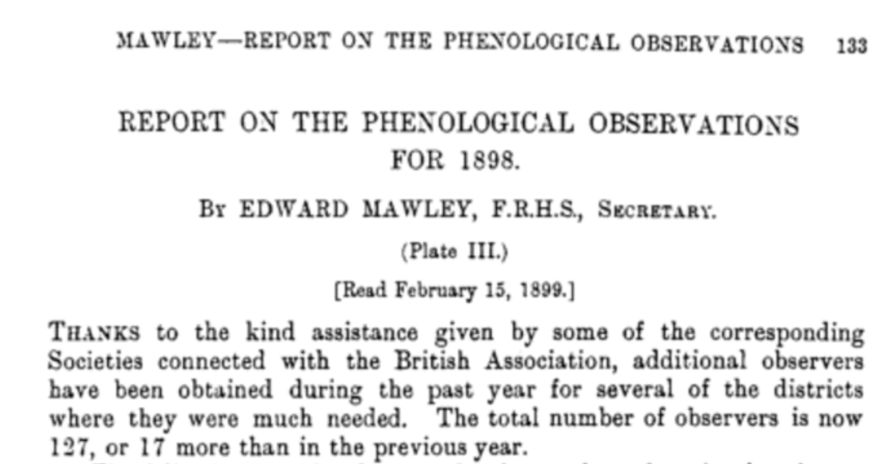
What about other data resources
Citizen science phenology monitoring programs stretch back hundreds of years!
Some reporting “in the literature” e.g. British Met Soc.
And there are national and international programs still going
Lots of data – but all require care handling

Slide 25
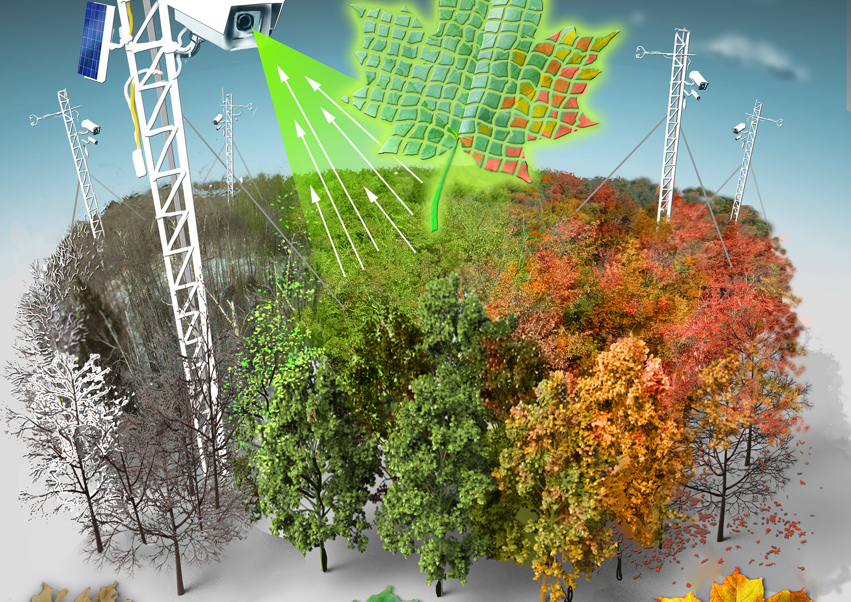
One last resource
Phenocams are cameras with special sensors
They are deployed to form a broad network globally
They monitor phenology at the community level
And are more focused on leaf phenology
May be hard to assemble with “whole plant” observations.

Slide 26
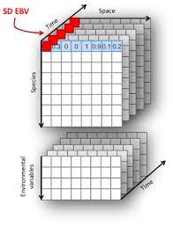
So how do we actually make phenology estimates
In most cases we are interested in “species-cell-year” combinations
What was the phenology of species X in Year Y in location Z?
And we want to link those phenoestimates with environmental estimates from those same years & locations
The way we do this utilizes R and its excellent tools for aggregating data into spatial and temporal units
This has become even easier with packages such as “sf”

Slide 27
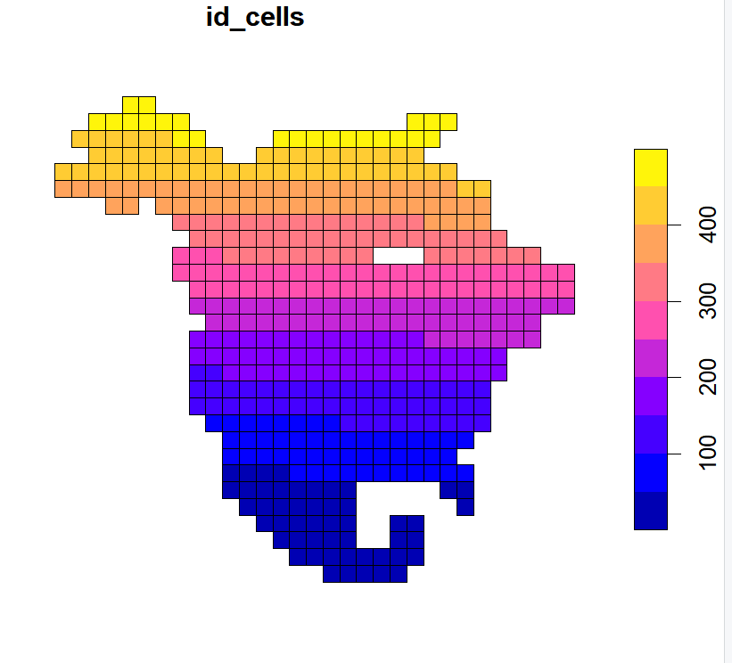
Phenoestimates 2 – Getting the last few yards
We can use just a few lines of code in R to generate a gridded map of North America – this is at coarse grain (250kmx250km) resolution
Use an equal area map not latitude and longitude
Make sure to number your grid. It’s super easy! e.g. mutate(st_sf(geometry = grids2), id_cells = 1:n()
Now we can take our presence records, convert them to the same projection, and then spatially join them to the grid
We need to do that per year and per species (use group_by)
We also need to filter those cells that don’t have enough records for phenoestimates (this number varies – how do you choose?)
And once done - you can use Phenesse to make estimates!

Slide 28
Phenoestimates3: Let’s dig in: filtering cells that don’t have enough records
I have focused on the following criteria
Number of unique observations
Number of unique observers
So what do we do?
Filter out specimen records collected by the same person on the same day in the same location
Count the number of observations and observers in each cell/year/species unit.
If observation count is below 6 or 7 and observer count is below 4 or 5 – estimating edges of the phenology phase (onset or offset) is very hard.
So filter out cells with low observation/observer #
BUT you may still get ok mean estimates with even fewer recs.
Always keep your observation count and observer count associated with cell/year/species – WHY?

Slide 29

Before we go further
I want to reiterate that methods I cover here are presence-only
You can fit presence-absence models but…
Absence is tricky from herbarium and iNaturalist data
Less so from monitoring data e.g. NPN
The issue is that absence must be assessed at the whole plant level and we often only have evidence from “part” of a plant
Happy to talk about methods for fitting presence-absence models individually

Slide 30
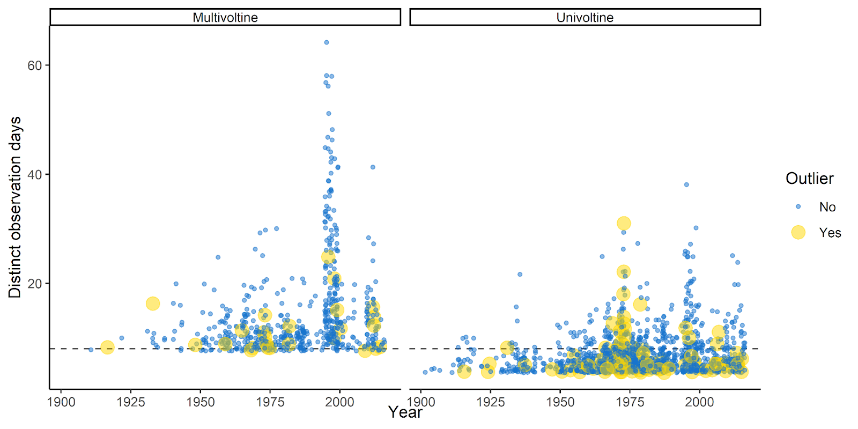
A good next step: Check for Outliers in your estimates
We often check for outliers in phenoestimates
These are per species and usually are 3SD away from mean phenology or more
The reason is that it is hard to remove all the issues with erroneous specimen data
These can be removed or checked to see if there is something obvious driving the outlying value
It’s often date issues with recs

Slide 31
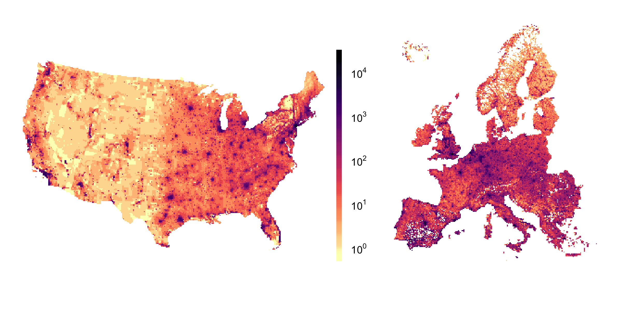
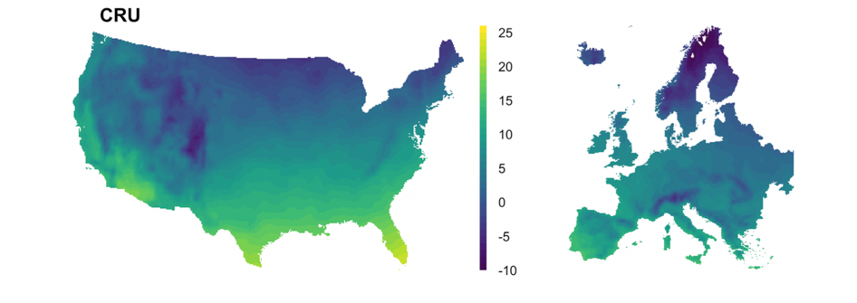
How do we assemble “covariate” data for testing phenology drivers?
Our group has focused on the following things:
Climatic drivers
Urbanization drivers
Species traits
If your questions are purely spatial, you can simply gather climate or urbanization data at the relevant time period and associate the climate data with your phenoestimates
Human population density (log-scale) (2010)
Temperature from November-May averaged 2010-2018

Slide 32
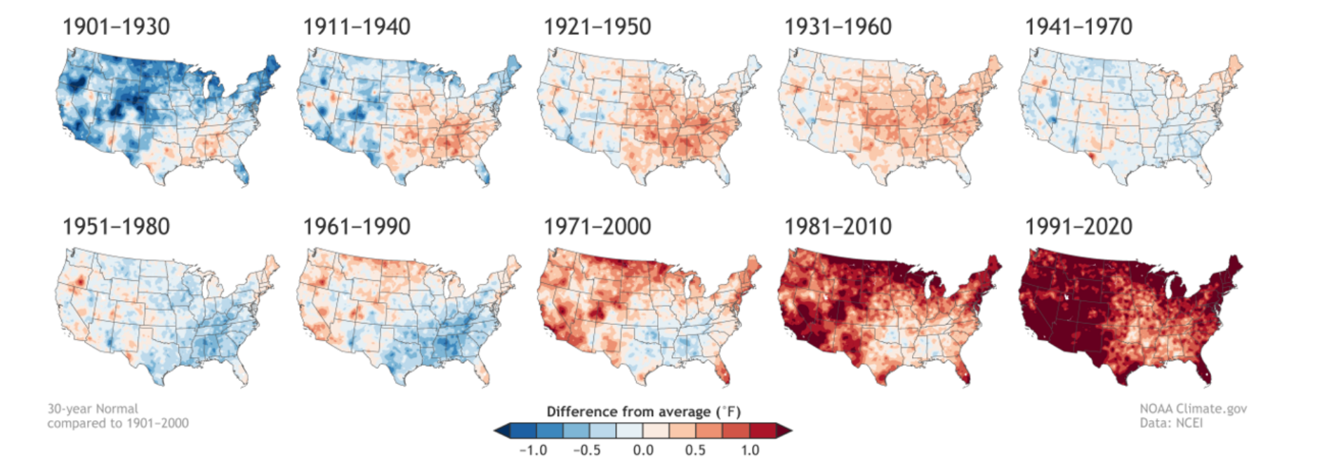
Climate data – p2
There are extensive historical climate data resources that stretch back to 1900
These are often at the the yearly or monthly level (CRU, for example)
There are even DAILY data that have been estimated back to 1910s
These all require some work to use in your analyses
Often you need to aggregate values to get estimates at the same spatial resolution as your grid cells
R again has everything you need for this --- sf, raster (and terra and stars) and tidyverse take you a long way here

Slide 33
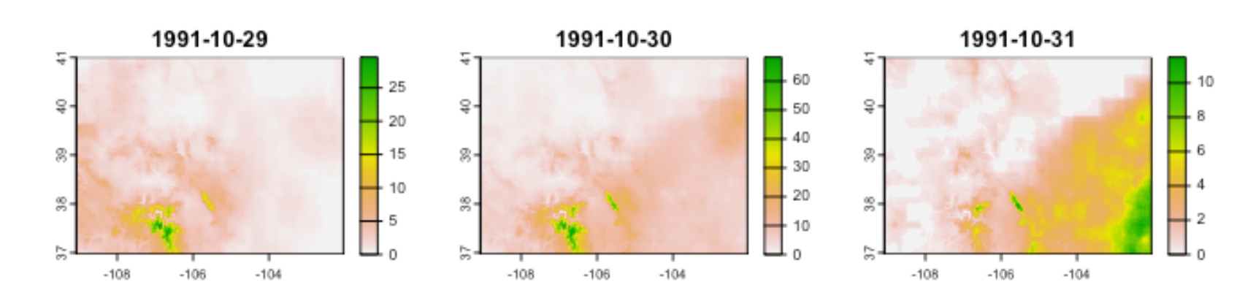
Climate data – p3
R again has everything you need for this but let’s unpack this
sf, terra and stars (and older packages e.g. raster and sp) are core GIS toolkits
They help you manipulate “vector” data e.g. shapefiles
And “raster” data e.g. gridded climate data
sf plays well with tidyverse, and this makes aggregation or extraction (e.g. get a mean temperature value for a grid cell) easy
There are more and more tools to get climate data right from R
Here are some I use: climateR (access to many datasets), prism (access to PRISM data), daymetr (access to Daymet).

Slide 34

How about Traits?
These mostly come from the literature
Highly dependent on question of interest
One trait we have used a lot is “flowering season” (spring/summer/fall)
And defining these timing traits can be a challenge because spring itself varies spatially

Slide 35
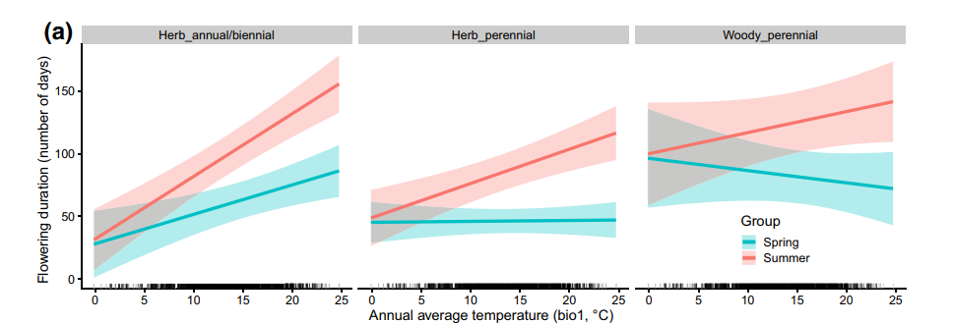
And finally, how do we use models to generate insights about phenology?
There are so many analysis pathways!
One of the more powerful ways to analyze phenology is in a linear mixed model framework
This provides a way to account for traits and climate as fixed effects and species and region as random effects
Accounting for phylogeny means having a tree with tips matching species for which you have phenoestimates

Slide 36
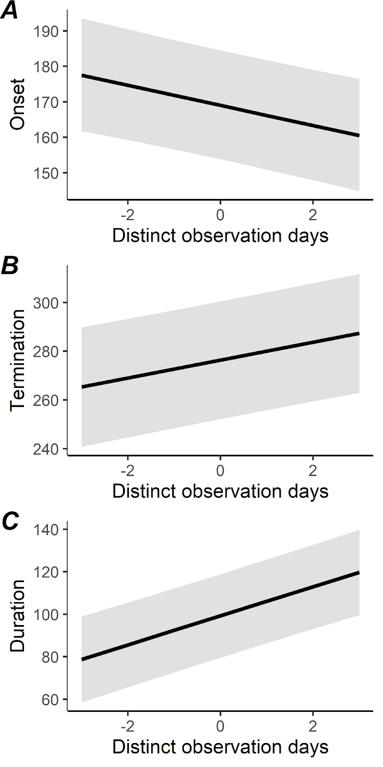
One more really important thing re: data assembly and models
You should always keep track of measures of observer effort for species-cell-year combos
We calculate “number of total observations” and “number of distinct collectors”
And we use one or both measures as “covariates” in our models
To account for observer effort
These variables almost ALWAYS show up in top models

Slide 37
Let’s summarize some tools most used:
We use digital images that have rich specimen occurrence metadata associated with them
We download images+metadata in R
And we do filtering – deduplication and other QA/QC in R
We score images for phenology states in imageant
We then join phenology state back to records in R
And then set up spatial grids and join records to those grids – so much tidyverse/dplyr!
We run species-year-grid cell phenoestimates in R using phenesse
And then use those in models also in R – here lme4 and phyr are the tools we use most

Slide 38
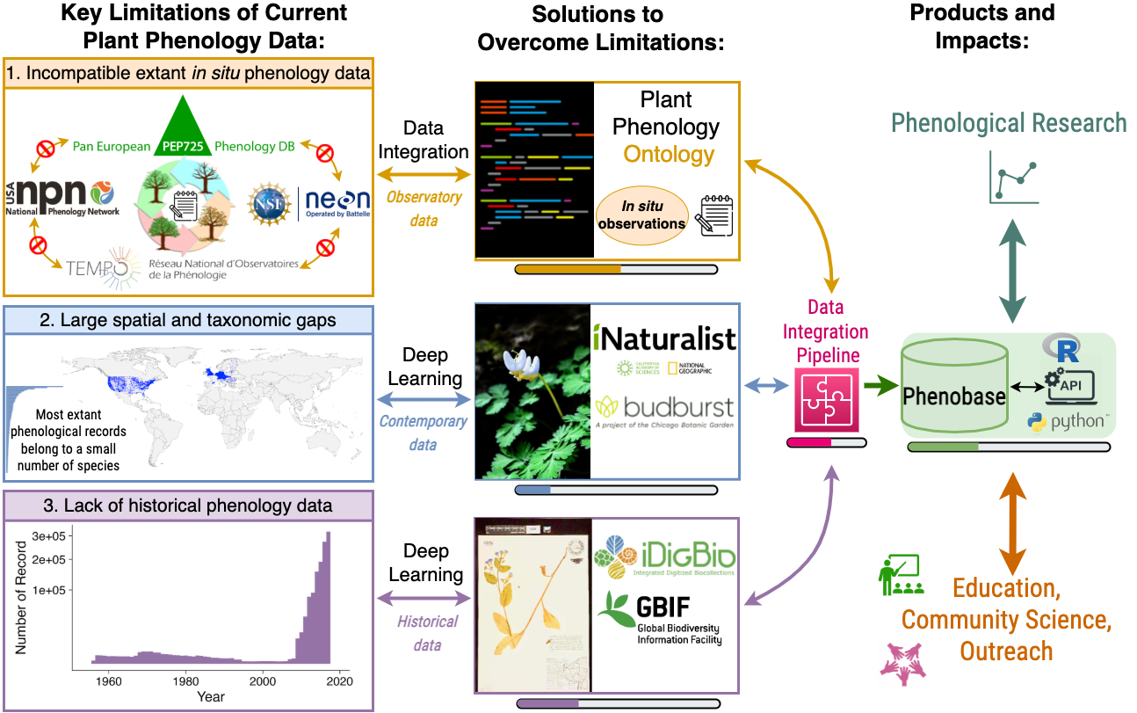
WHAT IF YOU DIDN’T HAVE TO DO ALL THAT ANNOTATION AND DATA ASSEMBLY YOURSELF? WELL SOON YOU WON’T BECAUSE PHENOBASE* WILL DO A LOT OF IT FOR YOU!
* started 9/2022

